Slide 1
Home Insurance dataset case study
Théo Chavannes

Slide 2
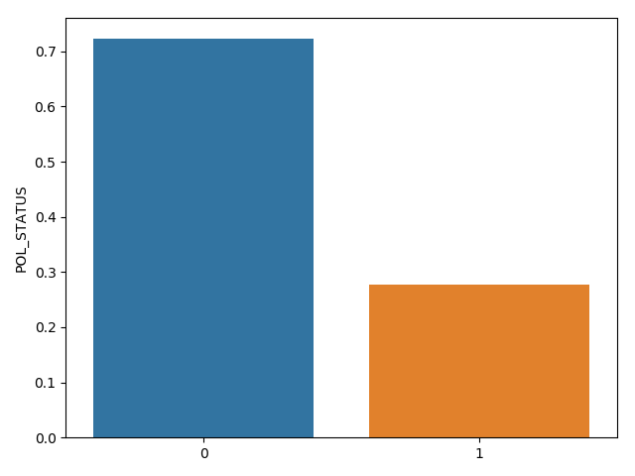
Introduction
This is a Home Insurance dataset including police's years between 2007 and 2012. Each police includes some significant characteristics of polices, building's characteristics, the zone, the privileges, the faults, some risk indicators and so on.
Goal: predict future lapsed cases

Slide 3
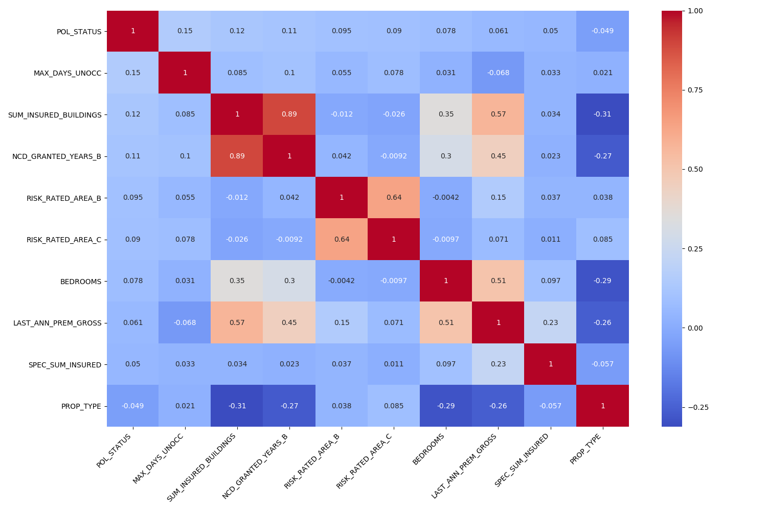
Data analysis: correlation matrix

Slide 4
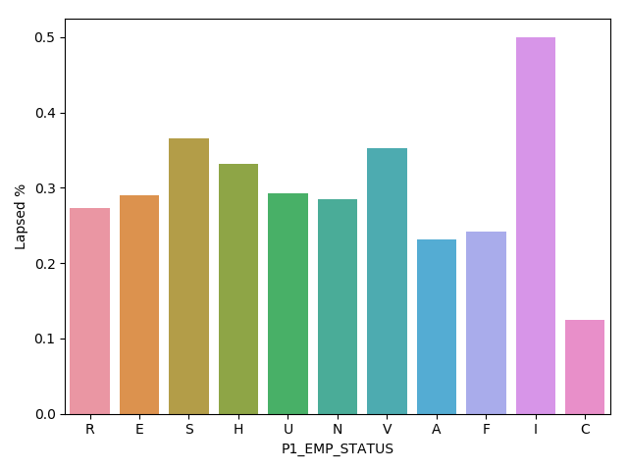
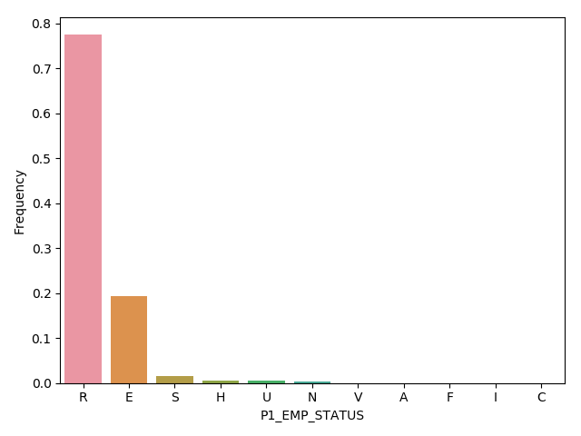
Data analysis: multi valued categorical features Employment status

Slide 5
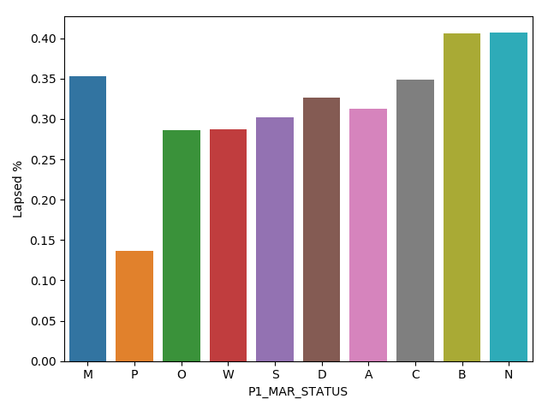
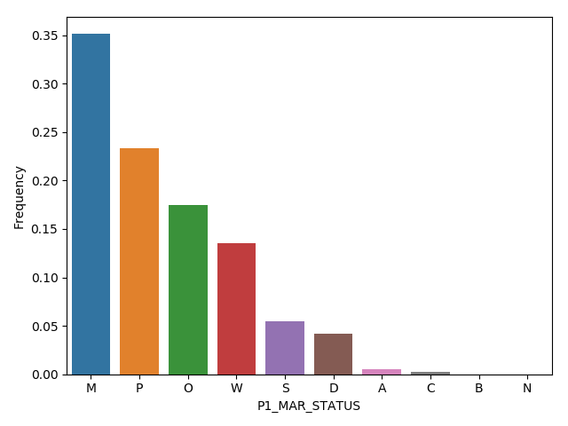
Data analysis: multi valued categorical features Marital status

Slide 6
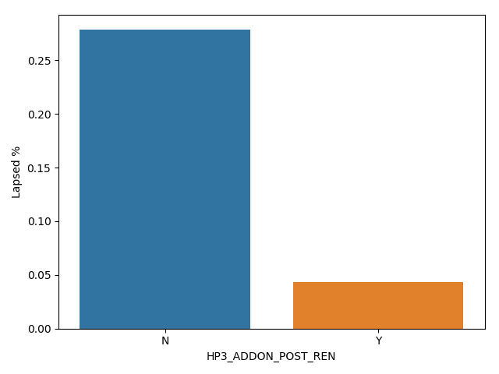
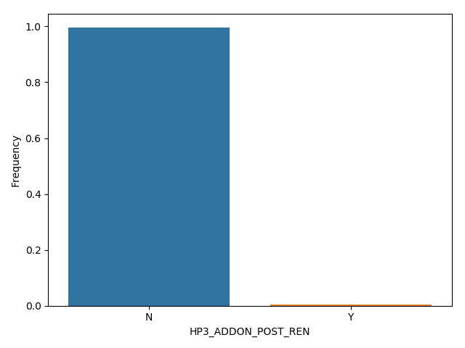
Data analysis: binary categorical features H3 ADDON POST REN
(Option "HP3" included after renewal)

Slide 7
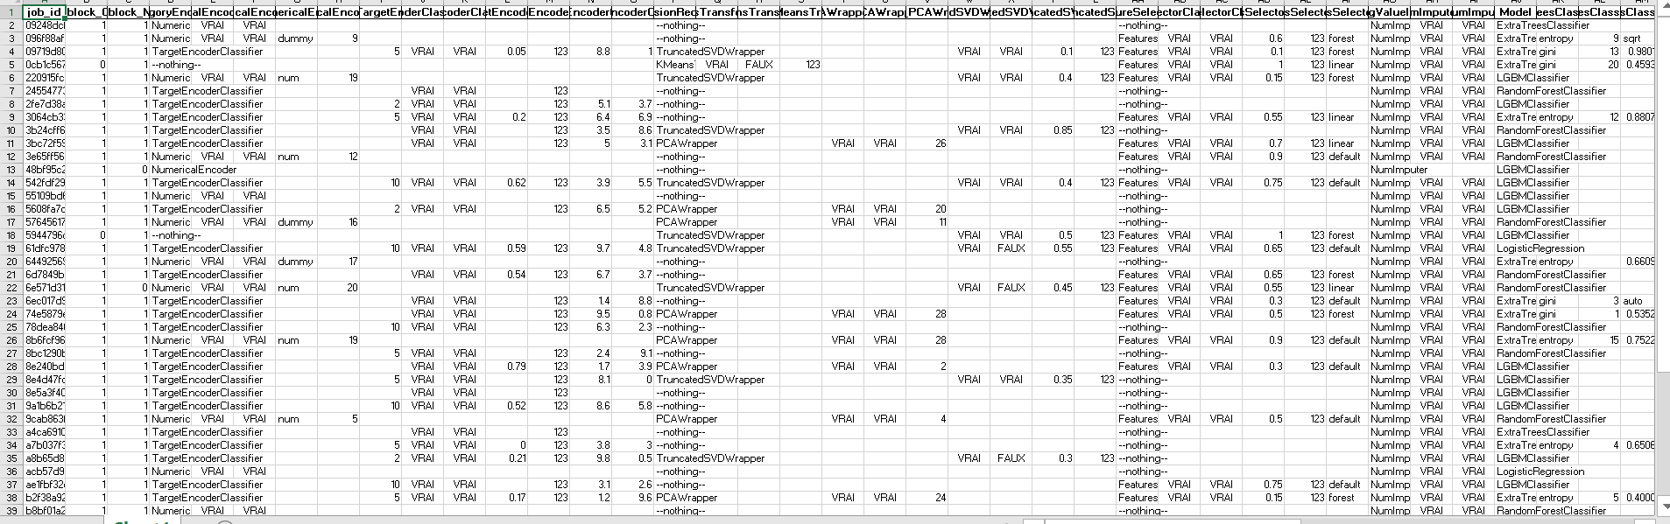
AUTOML, final model & results
Metrics = roc_auc; baseline_score: 0.58; best_model_score (lightgbm): 0.77

Slide 8
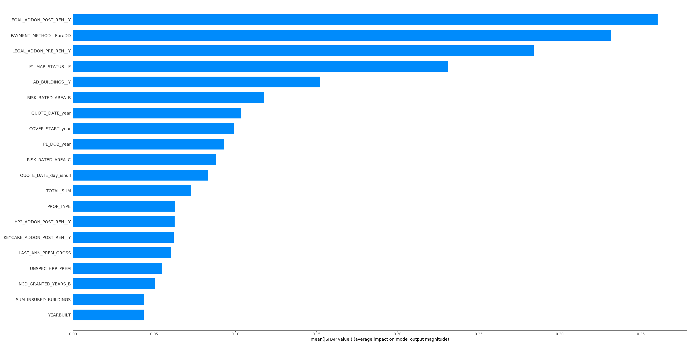
Features importances

Slide 9
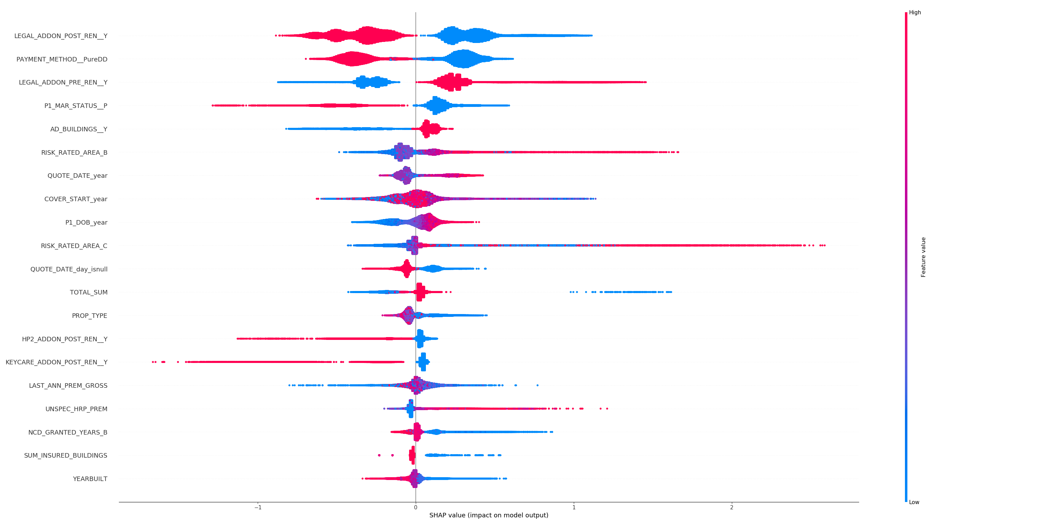
Shap plot

Slide 10
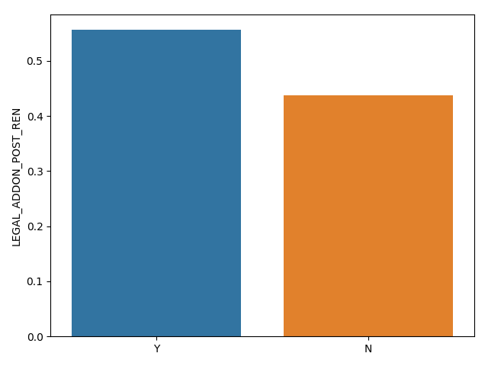
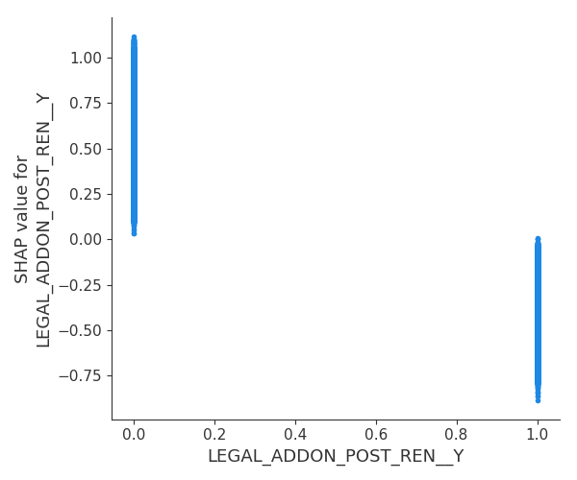
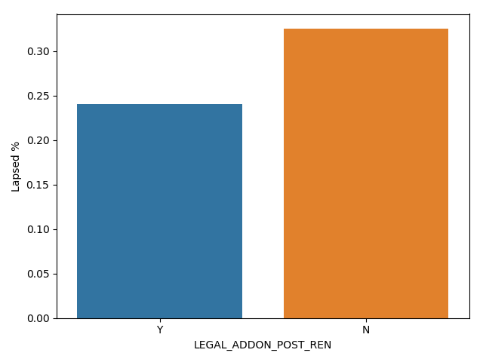
Dependence plots
Option "Legal Fees" included after 1st renewal

Slide 11
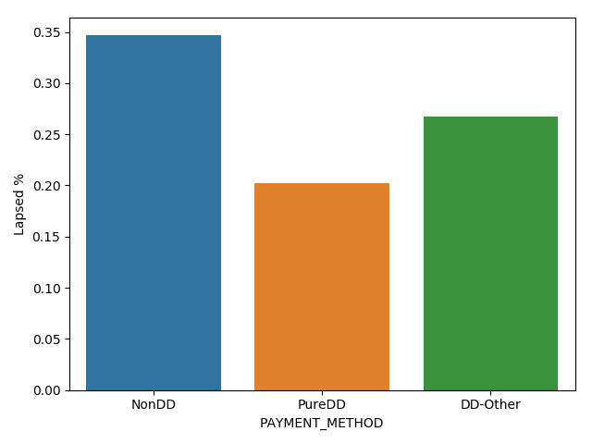
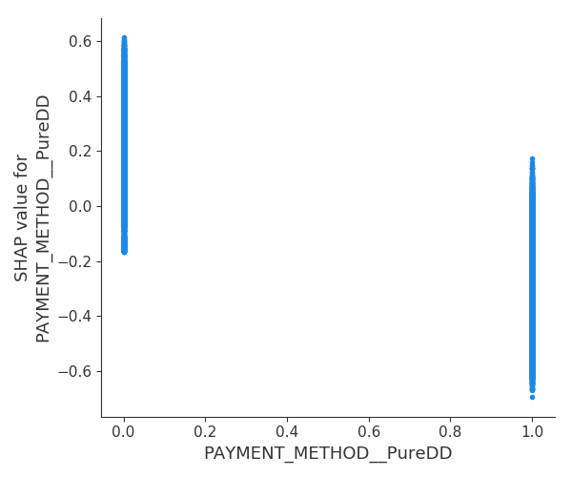
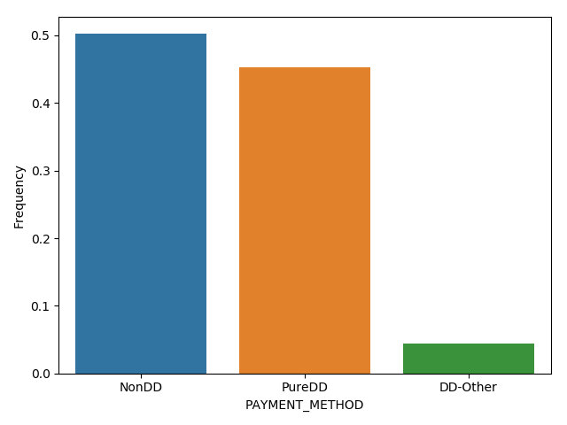
Dependence plot: PAYMENT_METHOD

Slide 12
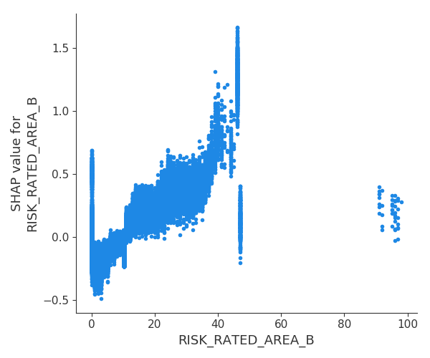
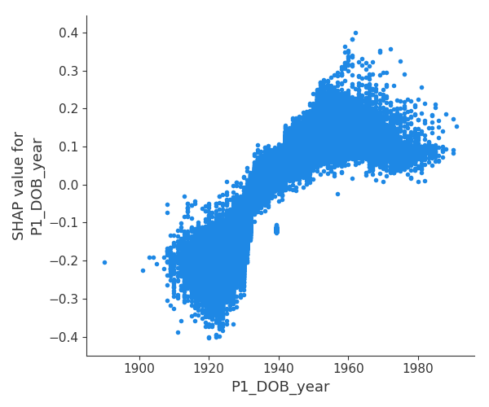
Dependence plots: P1_DOB_YEAR (birth year of the client) RISK_RATED_AREA_B (Geographical Classification of Risk – Building)

Slide 13
Delivering the solution
Package & code structure
Pickle of the predictor
Input of the predictor: json

Slide 14
Next steps
Check the different plots and investigate features which have some ”gaps” in the values taken, if possible interacting with business people, to be sure this is not some outliers in the data
Add some basic analysis based on the dates (not target-oriented) if we need to define a business strategy (it should be done at the right timing)
Improve feature engineering, especially by using some business knowledge
Tune the lightgbm
Probability calibration: lightgbm probabilities are not calibrated (it does not correspond to the common feeling of what a “probability” is)

Slide 15
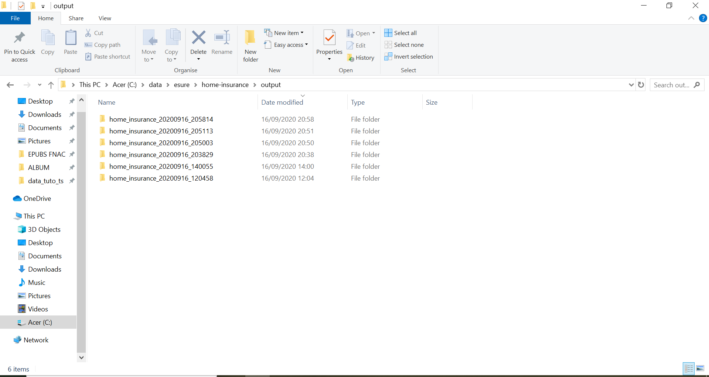
APPENDIX 1

Slide 16
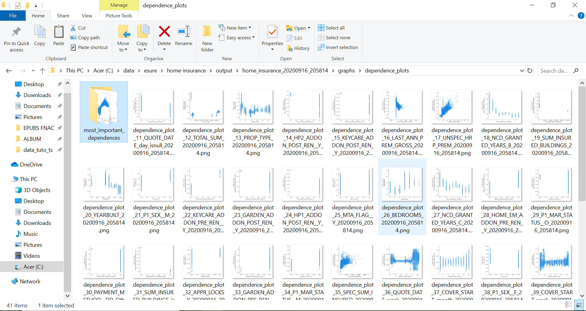
APPENDIX 2

